Slide 1
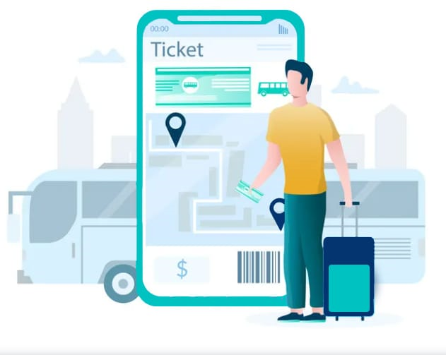
Web-Based Ticketing System for Public Transport
Dhanalakshmi R -192121105
Pramila -192121132

Slide 2
Table Of Content
Introduction
Problem Statement
Requirement Analysis
Implementation
Conclusion
References

Slide 3
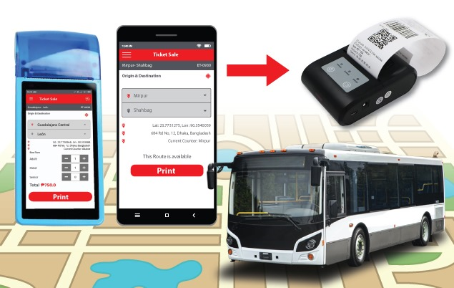
Introduction
The proposed Web-Based Ticketing System aims to enhance passenger convenience and optimize the ticketing process. The system will manage booking, ticket validation, and fare collection while providing analytics on passenger flow and revenue trends. Using cloud computing and database management techniques, the system will handle 50,000+ daily transactions, ensuring efficiency and scalability.
The system will feature a user-friendly interface for seamless booking and real-time ticket updates. Integration with multiple payment gateways will ensure secure and hassle-free transactions.

Slide 4
Problem Statement
Manual ticketing systems cause delays and inefficiencies.
Lack of real-time tracking and fare management.
Need for an automated, scalable system to manage high transaction volumes.
Absence of data analytics for optimizing transport operations.
Security concerns in traditional ticketing systems.
Difficulty in integrating multiple transport modes under a single system.

Slide 5
Requirement Analysis
Hardware
Software
Servers with high processing power
Cloud storage for secure data management
Network routers and high-speed internet
POS devices for ticket validation
Mobile devices for passengers to access e-tickets
Web-based application framework
Cloud computing services (AWS/Azure)
Database Management System (MySQL/PostgreSQL)
Payment gateway integration
AI-based predictive analytics for passenger flow

Slide 6
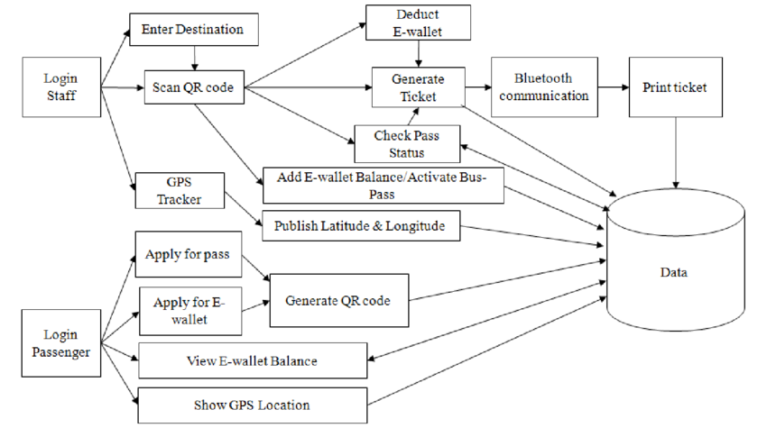
System Architecture
User Login & Access - Staff and passengers authenticate separately.
QR Code Ticketing - Tickets are generated, validated, and stored in a database.
GPS Tracking - Tracks buses and updates passenger location data.
Data Storage & Management - Stores transactions, balances, and pass activations securely.

Slide 7
Implementation
Database Design: Schema for transactions, users, and payments.
Web Application Development: Frontend (React/Angular), Backend (Node.js/Python).
Ticket Validation System: QR-based e-tickets with scanning.
Data Analytics Dashboard: Insights on passenger flow and revenue trends.
Security Measures: Encryption and access control.
Mobile App Development: A user-friendly mobile app for seamless ticketing and validation.

Slide 8
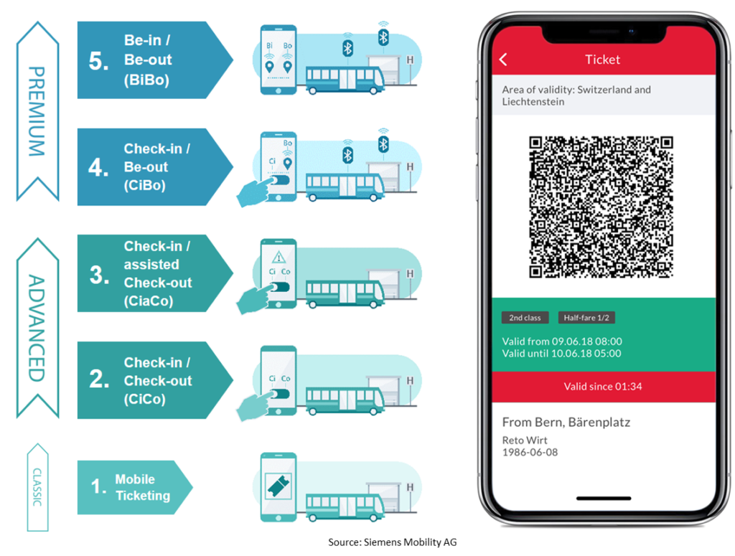
Future Enhancements
AI-driven fare prediction and demand forecasting
Blockchain-based ticketing for transparency
Multi-language support for accessibility
NFC and Bluetooth-based automatic check-in/check-out
Cloud-based real-time passenger data sharing for transport authorities
Augmented Reality (AR) navigation for better user experience

Slide 9
Conclusion
The Web-Based Ticketing System revolutionizes public transport by automating fare management and optimizing passenger convenience. The integration of cloud computing, DBMS, and analytics ensures a seamless and efficient ticketing process, ultimately improving public transport services. Additionally, AI-driven insights and mobile accessibility make it a future-ready solution.

Slide 10
References
Designing Data-Intensive Applications" – Martin Kleppmann (2017)
Cloud Computing: Concepts, Technology & Architecture" – Thomas Erl, Ricardo Puttini, Zaigham Mahmood (2013)
Database System Concepts" – Abraham Silberschatz, Henry F. Korth, S. Sudarshan (7th Edition, 2019)
Web Development and Design Foundations with HTML, CSS, JavaScript" – Terry Felke-Morris (9th Edition, 2019)
E-Business and E-Commerce Management" – Dave Chaffey (6th Edition, 2014)

Slide 11
THANK YOU

